Slide 1

Operating Systems & Embedded Systems Design
OS & ESD (23EECC304)
Course Project under the course
Title : Dynamic Keypad Menu with Threshold Management of multiple sensors .
 | TEAM DETAILS – TEAM No. 04
 | Sl. No | Roll No. | Div | SRN | Name
 | 1 | 553 | E | 01FE23BEC287 | SURAJ ALAGOUDA
 | 2 | 552 | E | 01FE23BEC286 | SAHANA MATHAPATI
 | 3 | 556 | E | 01FE23BEC290 | ARCHANA.HOSAMANI
 | 4 | 557 | E | 01FE23BEC291 | ANISHA .DSOUZA
Under the Guidance of Supriya V. Katwe

Slide 2
PROBLEM STATEMENT
OS & ESD (23EECC304)
Title : Dynamic Keypad Menu with Threshold Management of multiple sensors .
The objective of this project is to design and implement an RTOS-based dynamic keypad menu system using the ARM Cortex-M3 LPC1768 microcontroller. The system allows the user to set and modify threshold values for temperature, gas concentration, and distance parameters through a 4×4 keypad interface.
The threshold entered through the 4×4 keypad for each sensor is used to generate an alert for that respective sensor.
All the above-mentioned functionalities should be visualized through LCD display at each and every stage.
The system should be implemented to run using a Real-Time Operating System (RTOS).

Slide 3
INTRODUCTION
OS & ESD (23EECC304)
Safety monitoring is a critical requirement in industrial, domestic, and laboratory environments where parameters such as distance, gas concentration, and temperature must be continuously observed to prevent hazardous conditions. In this project, an RTOS-based safety monitoring system is implemented using the ARM Cortex-M3 LPC1768 microcontroller to provide reliable, real-time supervision of these parameters.
The system integrates an ultrasonic sensor for distance measurement, a gas sensor for detecting harmful gas levels, and a DHT11 sensor for temperature monitoring. A 4×4 keypad is used to allow the user to select the monitoring mode and set safety threshold values dynamically, while a 16×2 LCD displays real-time sensor readings and system status. When any parameter exceeds its predefined threshold, visual alerts using LEDs and an audible buzzer are activated.
An RTOS (Real-Time Operating System) is employed to manage concurrent sensor tasks efficiently, ensuring deterministic operation, proper task synchronization, and safe shared resource access using a mutex for LCD control. This approach improves system responsiveness, scalability, and reliability compared to conventional polling-based designs.

Slide 4
PROBLEM ANALYSIS
OS & ESD (23EECC304)
FEATURES SELECTED
Multi-parameter monitoring of distance, gas concentration, and temperature .
User-configurable thresholds using a 4×4 keypad for flexibility under different conditions.
Real-time status display on a 16×2 LCD for continuous feedback.
Visual and audible alerts using LEDs and a buzzer to indicate unsafe conditions.
Concurrent task execution using an RTOS to handle multiple sensors efficiently.
Safe shared resource access using a mutex to protect LCD operations.
JUSTIFICATION FOR EACH DESIGN CHOICE
LPC1768 Microcontroller
Chosen for its ARM Cortex-M3 core, built-in 12-bit ADC, multiple GPIOs, timer peripherals, and RTOS support, making it suitable for real-time embedded applications.
Ultrasonic Sensor
Provides non-contact distance measurement, suitable for obstacle or proximity-based safety detection.
3. Gas Sensor (Analog Type)
Enables detection of harmful gases through analog voltage variation, easily interfaced using the microcontroller’s ADC.
4. DHT11 Temperature Sensor
Selected for its digital output, simple single-wire interface, and ease of integration for basic temperature monitoring.
4×4 Keypad
Allows menu-driven user interaction and dynamic threshold setting without requiring external devices.
6. 16×2 LCD
Provides a low-cost and effective interface to display sensor values, thresholds, and system status.
7. LEDs and Buzzer
Offer immediate visual and audible alerts, improving user awareness during unsafe conditions.
ASSUMPTIONS MADE
The operating environment uses standard atmospheric conditions, assuming a constant speed of sound for ultrasonic distance calculation.
Only one sensor mode is active at a time, selected through the keypad.
Gas sensor output voltage is within the ADC input range (0–3.3 V) of the microcontroller.
The DHT11 sensor provides integer temperature values, sufficient for basic safety monitoring.

Slide 5
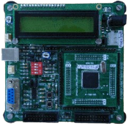
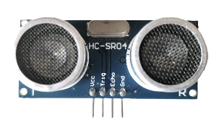
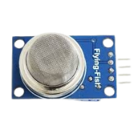
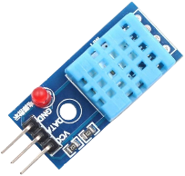
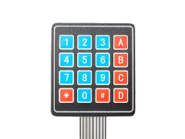
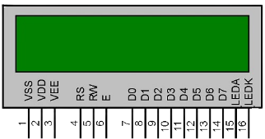

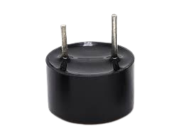
Peripherals Chosen for Prototyping
OS & ESD (23EECC304)
SL. NO | PERIPHERAL | PERIPHERAL IMAGE
1. | LPC1768 Microcontroller
2. | Ultrasonic sensor (HC-SR04 type)
3. | Gas sensor (Analog output)
4. | DHT11 temperature sensor
5. | 4×4 matrix keypad
6. | 16×2 LCD
7. | LEDs and buzzer

Slide 6
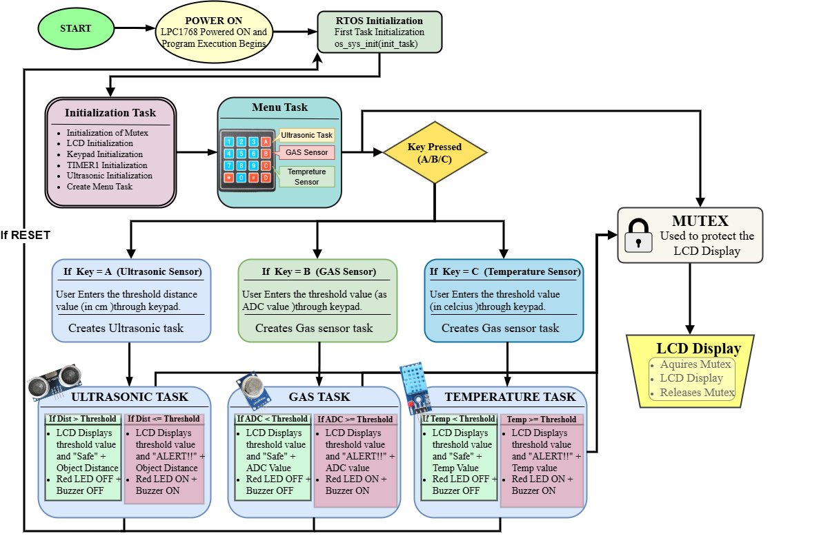
FLOW CHART
OS & ESD (23EECC304)

Slide 7
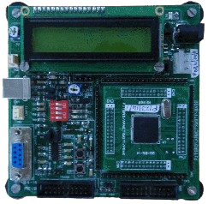
Specifications of All Peripherals Used & Calculations
OS & ESD (23EECC304)
1.Microcontroller – LPC1768 (ARM Cortex-M3)
Specifications :
Core: ARM Cortex-M3
Operating voltage: 3.3 V
Clock frequency: Up to 100 MHz
GPIO ports: GPIO0 – GPIO4
ADC resolution: 12-bit
Timers: 32-bit Timer0–Timer3
RTOS support: Keil RTX

Slide 8
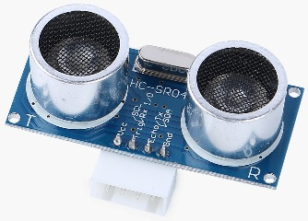
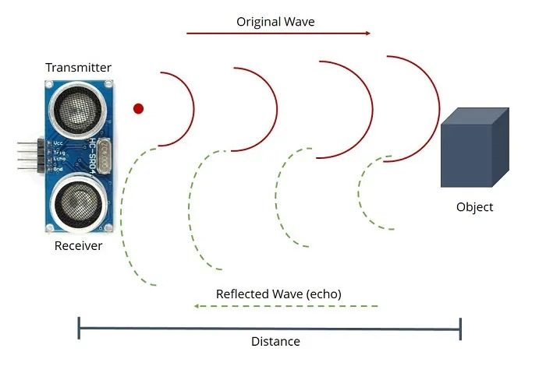
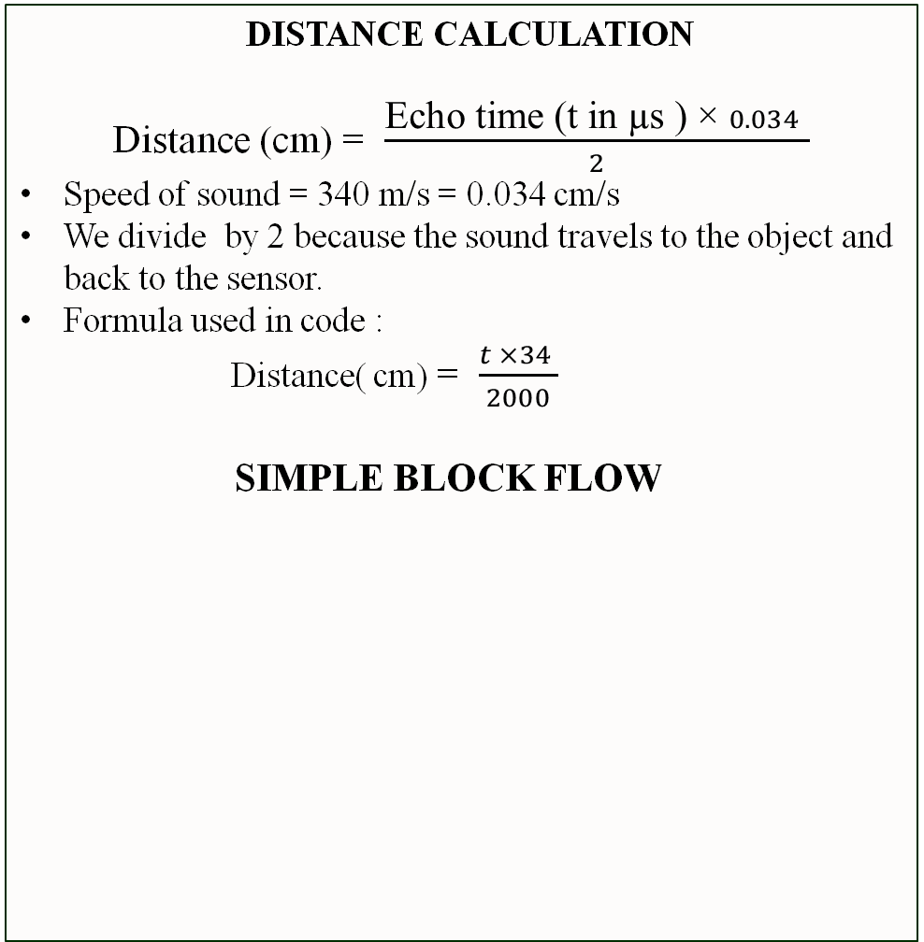
OS & ESD (23EECC304)
2. ULTRASONIC SENSOR
Specifications
Operating voltage: 5 V
Operating frequency: 40 kHz
Measuring range: 2 cm – 400 cm
Interface pins: TRIG, ECHO
GPIO Pins Used
TRIG → P0.0 (Output)
ECHO → P0.1 (Input)
Ultrasonic Function :
Sends an ultrasonic pulse .
Measures echo time.
Convert time to distance
DISTANCE CALCULATION
Distance (cm) = $\frac{\text{Echo} \text{time}\text{ (}\text{t} \text{in}\text{ µ}\text{s}\text{ ) ×} 0.034 }{2}$
Speed of sound = 340 m/s = 0.034 cm/s
We divide by 2 because the sound travels to the object and back to the sensor.
Formula used in code :
Distance( cm) = $\frac{t ×34 }{2000}$
SIMPLE BLOCK FLOW
TRIG (P0.0)
Ultrasonic sensor sends 40KHz sound wave
Object detected
Timer 1 measures the pulse width
ECHO (P0.1)
Distance calculated in cm.

Slide 9
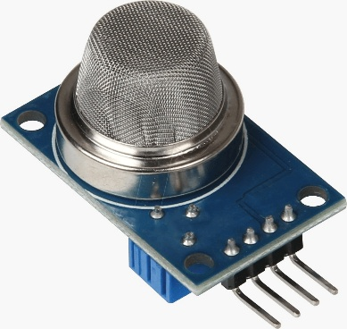
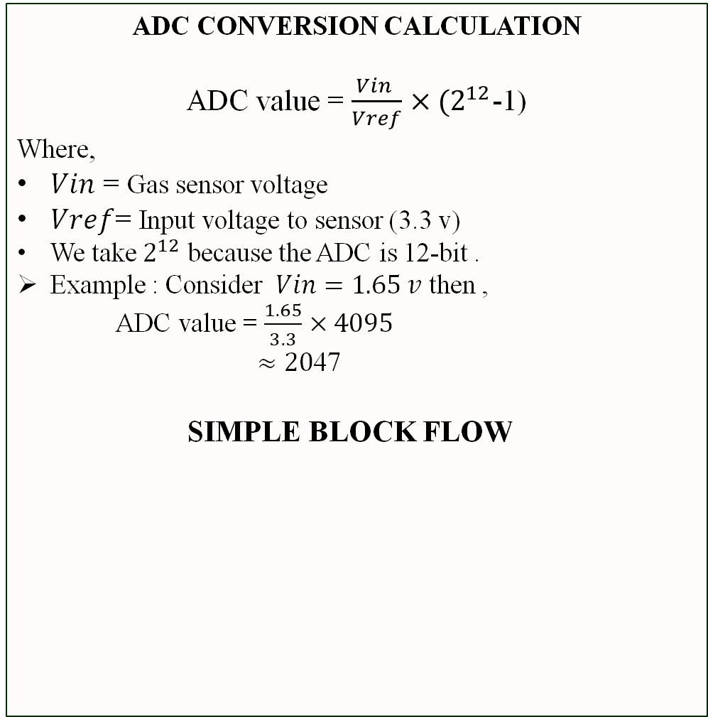
OS & ESD (23EECC304)
3. GAS SENSOR
Specifications
Operating voltage: 5 V
Output type : Analog voltage
Detectable gases: Smoke , LPG etc
Output range: 0 – 3.3 V
ADC Configuration
ADC channel: AD0.0
GPIO pin: P0.23
Resolution: 12-bit
ADC range: 0 – 4095
How gas sensing works ?
Inside the gas sensor it contains the heated metal-oxide (SnO₂) element.
When the sensor detects any smoke or gas the sensor resistance decreases which increases the voltage.
This analog voltage is converted to digital value using the ADC .
Higher gas concentration = Higher output voltage .
ADC CONVERSION CALCULATION
ADC value = $\frac{Vin }{Vref}$ $×(2^{12}$-1)
Where,
$Vin$ = Gas sensor voltage
$Vref$= Input voltage to sensor (3.3 v)
We take $2^{12}$ because the ADC is 12-bit .
Example : Consider $Vin=1.65 v$ then ,
ADC value = $\frac{1.65}{3.3}$ $×4095$
$≈20$47
SIMPLE BLOCK FLOW
Gas sensor
Analog Voltage
(0 -3.3 V)
AD0.0 (P0.23)
Digital Value
(0 -4095)
ADC (12-bit)

Slide 10
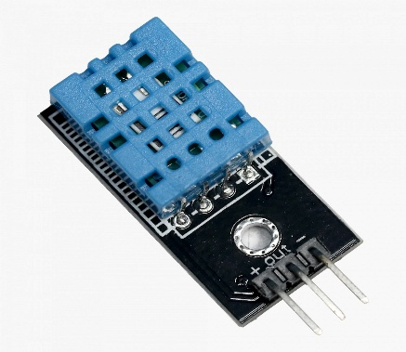
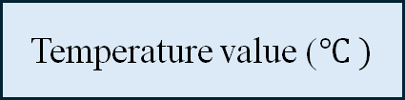
OS & ESD (23EECC304)
4 . TEMPERATURE SENSOR (DHT11)
Specifications
Operating voltage: 3.3 V - 5 V
Temperature range: 0°C – 50°C
Resolution: 1°C
Output type: Digital value
GPIO Pins Used
DATA → P0.16 (Bi-directional GPIO)
Temperature Measurement:
DHT11 internally uses an NTC thermistor
As Resistance ↓ as temperature ↑
Internal ADC converts temperature to digital data
MCU reads 40-bit data frame
Temperature extracted directly in °C
NOTE: No external calculation required .
SIMPLE BLOCK FLOW
As Temperature Changes the internal resistance Changes
DHT11 Internal sensor
Digital data ( 40 –bit)
MCU decodes bits
Temperature value ($℃ )$

Slide 11
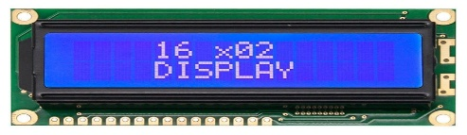
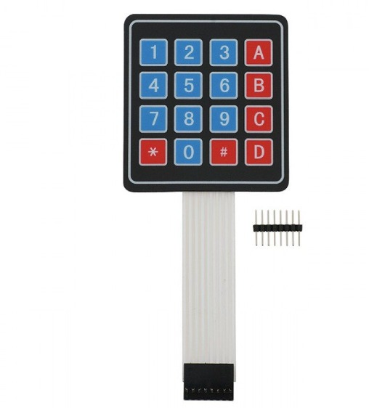
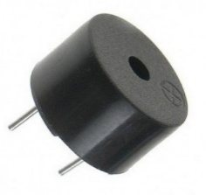
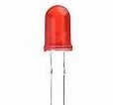
OS & ESD (23EECC304)
5. LCD DISPLAY
Specifications
Operating voltage: 5 V
Interface mode: 4-bit
Display: 16 characters × 2 lines
GPIO Pins Used
RS (Register Select) → P3.25
RW (Read / Write) → P3.26
E (Enable ) → P4.28
D4–D7 (Data Bus) → P1.20 – P1.23
7. 4×4 Matrix KEYPAD
Specifications
Keys: 16
Interface type: Matrix scanning
Operating voltage: 3.3 V
GPIO Pins Used:
Rows (Output): P0.4 – P0.7
Columns (Input): P0.8 – P0.11
Keypad Scanning Logic
Rows driven LOW one at a time
Columns monitored for LOW
Row + Column → Key identification
6. LEDs & BUZZER
Specifications
LEDs and Buzzer
Current: 10–15 mA
Buzzer voltage: 5 V
GPIO Pins Used :
Ultrasonic RED LED → P0.25
Gas Sensor RED LED → P0.17
Temperature Sensor RED LED → P0.15
Buzzer → P0.24

Slide 12
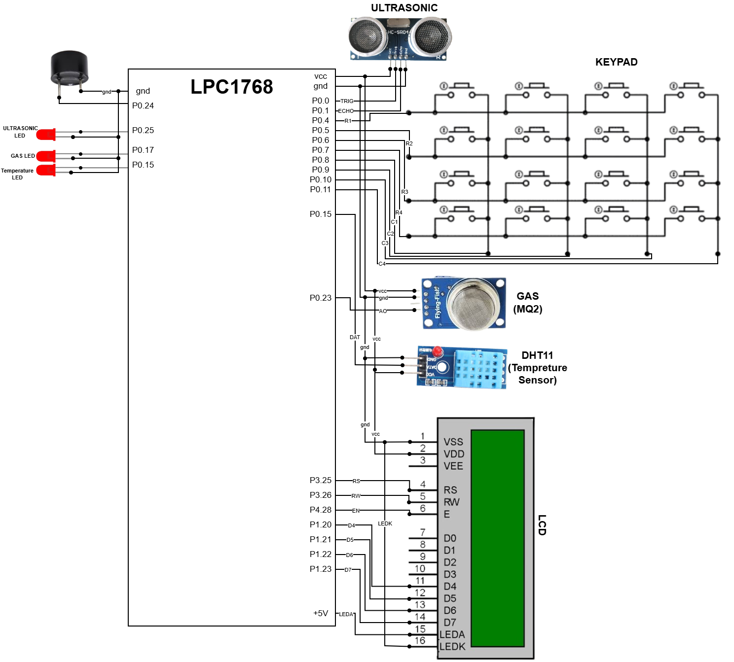
INTERFACING DIAGRAM
OS & ESD (23EECC304)

Slide 13
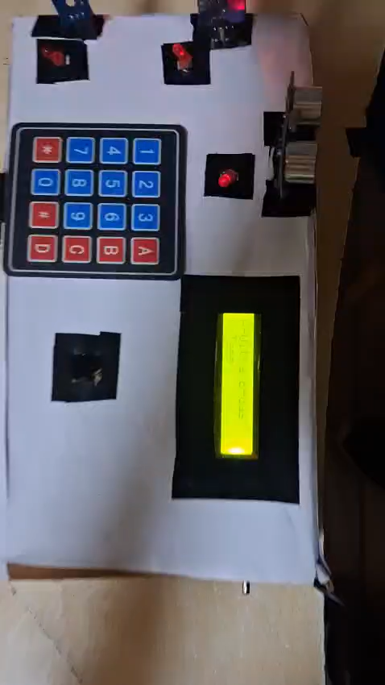
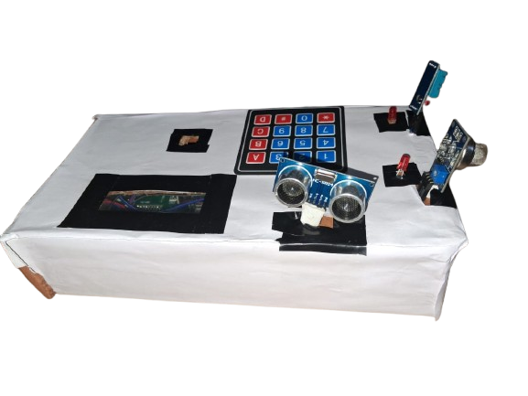
RESULTS
OS & ESD (23EECC304)
PROTOTYPE IMPLEMENTED
WORKING VIDEO

Slide 14
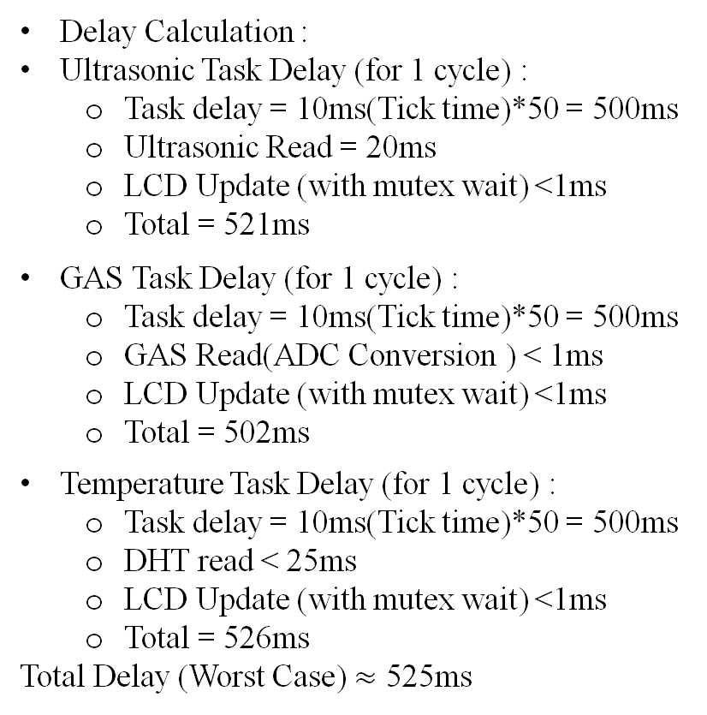
RESULTS
OS & ESD (23EECC304)
TIMING ANALYSIS
MEMORY ANALYSIS
Delay Calculation :
Ultrasonic Task Delay (for 1 cycle) :
Task delay = 10ms(Tick time)*50 = 500ms
Ultrasonic Read = 20ms
LCD Update (with mutex wait) <1ms
Total = 521ms
GAS Task Delay (for 1 cycle) :
Task delay = 10ms(Tick time)*50 = 500ms
GAS Read(ADC Conversion ) < 1ms
LCD Update (with mutex wait) <1ms
Total = 502ms
Temperature Task Delay (for 1 cycle) :
Task delay = 10ms(Tick time)*50 = 500ms
DHT read < 25ms
LCD Update (with mutex wait) <1ms
Total = 526ms
Total Delay (Worst Case) $≈$ 525ms
Code memory = 7644 Bytes (Flash Memory)
RO-Data (memory used by strings and look-up table) = 296 Bytes (Flash Memory)
RW-Data ( memory used by Initialized globals) = 56 Bytes (RAM Memory)
ZI-Data ( Stack + Heap ) = 2816 bytes ( RAM )
Total stack size = 200 bytes (50 byte for each task)

Slide 15
CONCLUSION
OS & ESD (23EECC304)
CHALLENGES FACED
SUMMARY OF OUTCOMES
Successfully designed and implemented a real-time embedded system using LPC1768 and RTX RTOS.
Integrated multiple sensors (Ultrasonic, Gas, DHT11) with actuators (LEDs, buzzer) for real-time monitoring.
Implemented multitasking using RTX, ensuring concurrent sensor operation .
Ensured safe shared resource access by implementing mutex-based synchronization for LCD operations.
Designed a menu-driven user interface using keypad and LCD for dynamic threshold configuration.
Validated the complete system through successful hardware testing and result analysis.
Accurate timing control was required for ultrasonic sensor and DHT11 communication.
Concurrent LCD access from multiple tasks caused display corruption initially, which was resolved using a mutex.
Managing multiple peripherals simultaneously under RTOS constraints required proper task structuring and synchronization.
Debugging real-time behavior and task execution order was challenging during integration.
Understanding each peripheral working and implementing proper RTOS Kernel object to it.

